Slide 2
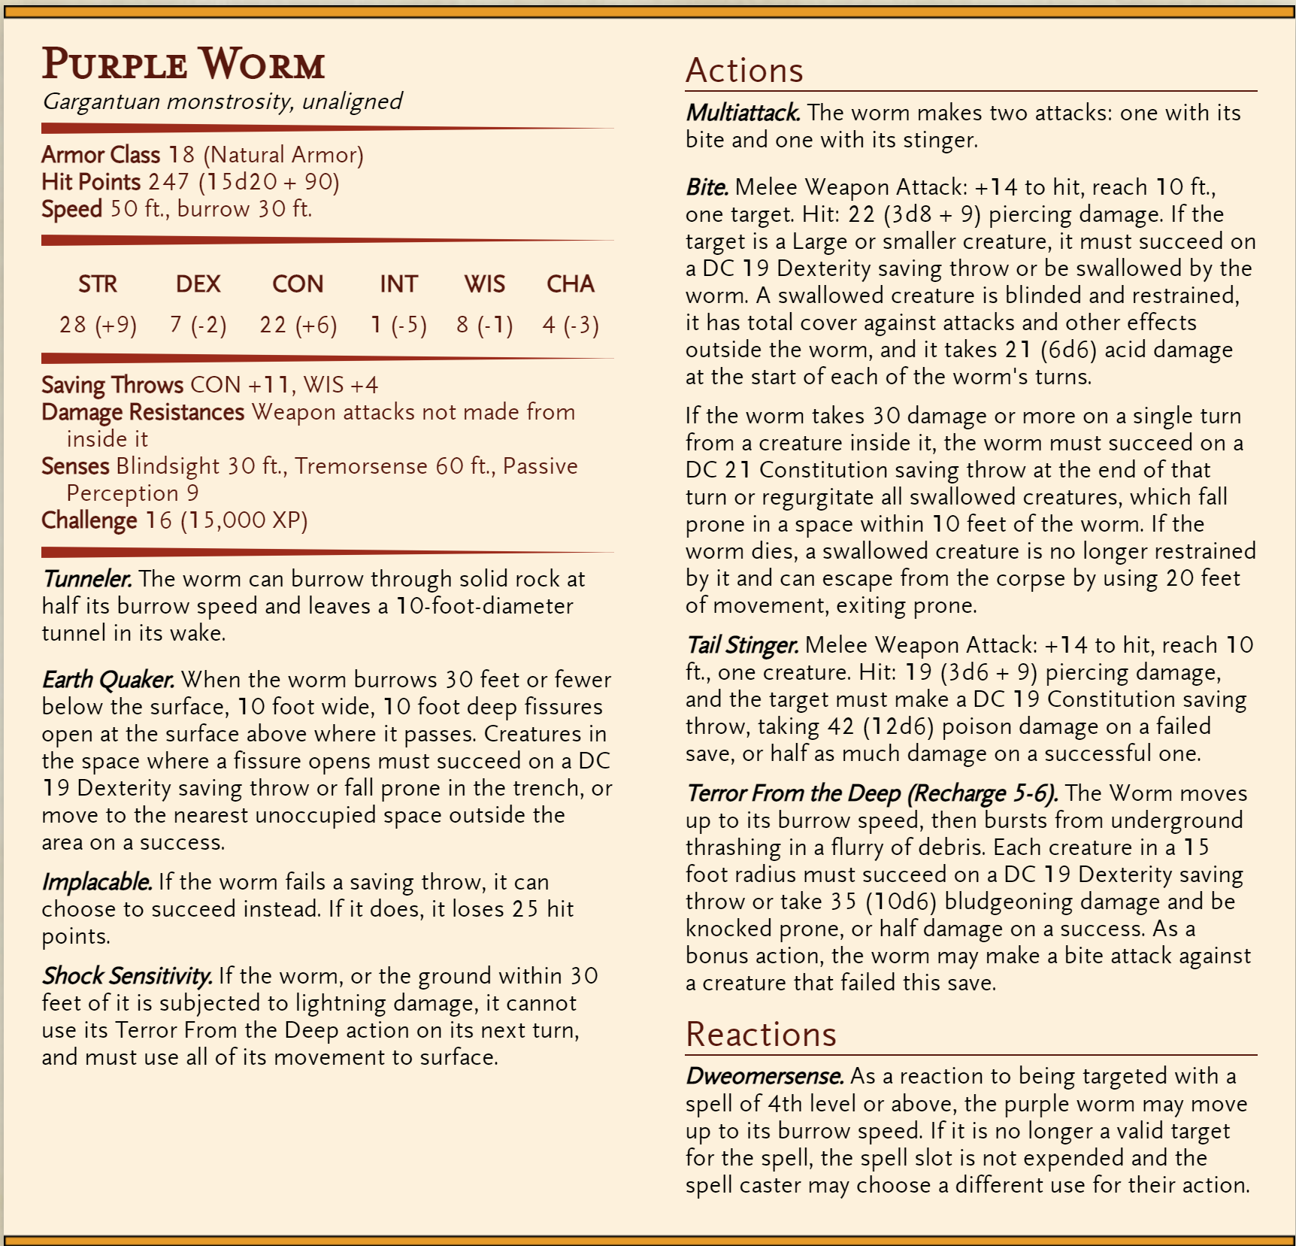
Muldvarp
Notes:
https://homebrewery.naturalcrit.com/share/159ov2pshLjrDRt3nPA6f3l6uVsqe4QA7PuQrQ1F6DuBz

